Slide 1
Introduction to Android Programming
Mobile Programming

Slide 2
Mobile Programming
This course involves a careful examination of mobile device programming.
Emphasis is on developing applications that run on the Android platform.
Students planning to enroll in this course should have background in computing and be familiar with Java.
The course introduces mobile application development for the Android platform.

Slide 3
Mobile Programming
Lecture1: Introduction
What is android?
Why Android?
Features of Android
Android Application
Android env’t setup
Android Architecture and code
Programming Languages for Android

Slide 4
What is Android?
An open source and Linux-based Operating System for mobile devices such as smartphones and tablet computers
Android offers a unified approach to application development for mobile devices which means developers need only develop for Android, and their applications should be able to run on different devices powered by Android.
The source code for Android is available under free and open source software licenses.

Slide 5
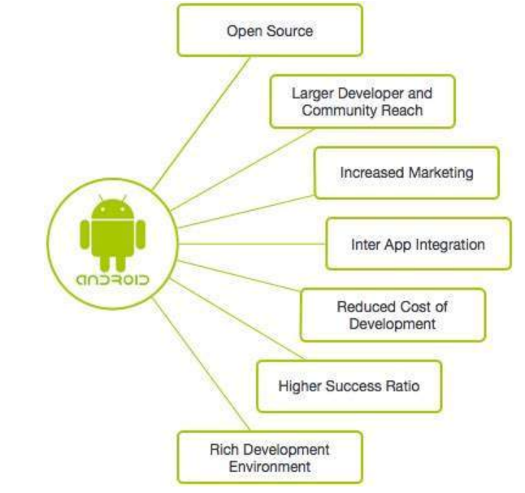
Why Android?

Slide 6
Features of Android
Beautiful UI
Android OS basic screen provides a beautiful and intuitive user interface
Connectivity
GSM/EDGE, IDEN, CDMA, EV-DO, UMTS, Bluetooth, Wi-Fi, LTE, NFC and WiMAX.
Storage
SQLite, a lightweight relational database, is used for data storage purposes.
Media support
Others: Messaging, Multi-tasking, Resizable widgets,

Slide 7
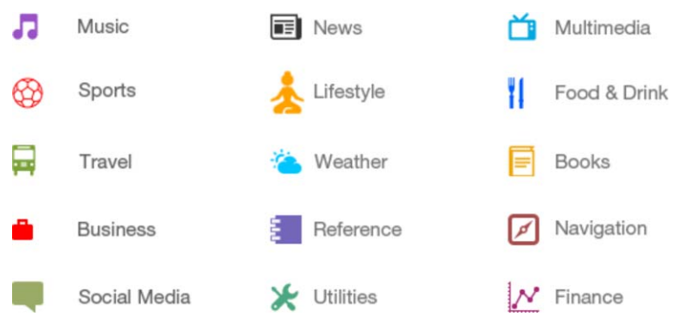
Android Applications
Android apps are usually developed in the Java language using the Android Software Development Kit.
Android apps can be packaged easily and sold out either through a store such as Google Play, SlideME, Opera Mobile Store, Mobango, F-droid and the Amazon Appstore
Some of the categories of Android apps

Slide 8
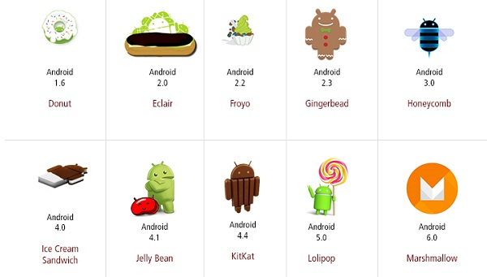
History of Android

Slide 9
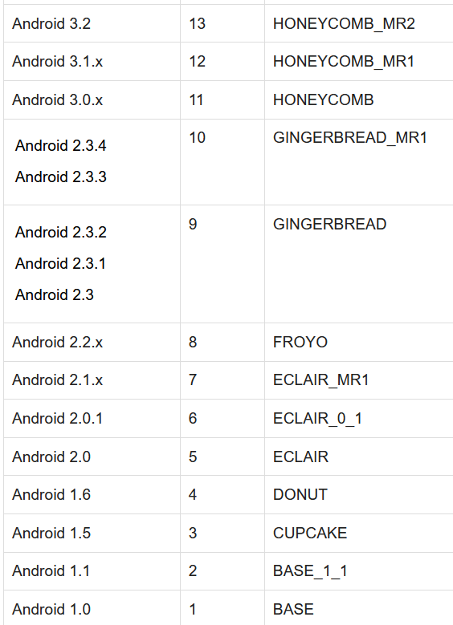
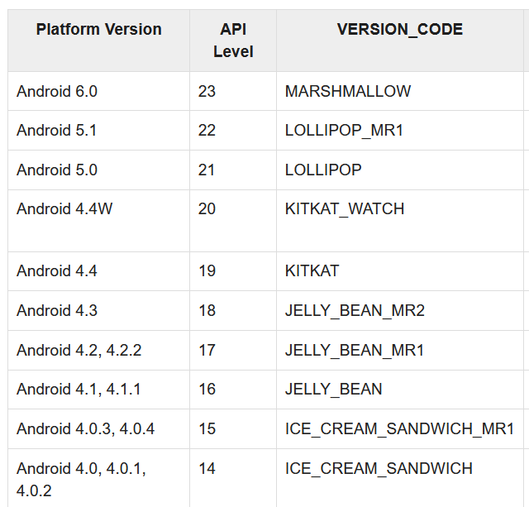
What is API level?
API Level is an integer value that uniquely identifies the framework API revision offered by a version of the Android platform.

Slide 10
Android – Environment Set up
Operating System
Microsoft Windows XP or later version.
Mac OS X 10.5.8 or later version with Intel chip.
Linux including GNU C Library 2.7 or later.
Required tools – all freely available and can be downloaded from the Web.
Java JDK5 or later version
Android Studio
Set up JDK
Right-click “My Computer” then “Select Properties”, then “Advanced”, then “Environment Variables”, then update the JAVE_HOME Path value and press OK
Example: “C:\Program Files\Java\jdk1.8.0_73”

Slide 11
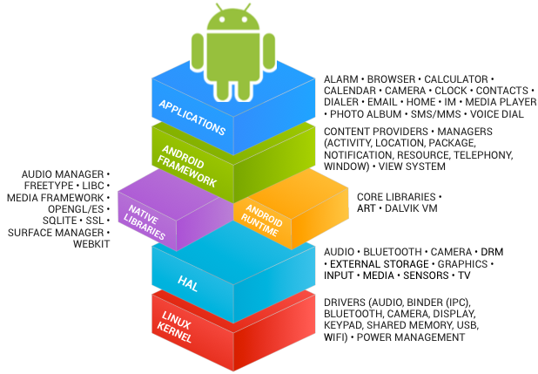
Android Architecture and Code
Developing Android apps involves interfacing with the Android platform and framework.

Slide 12
Cont…
Applications;
You will write apps to be installed on this layer only
Camera, Alarm, calculator, email, calendar….
Application Framework
Provides high level services to applications in the form of Java classes
Activity manager, window manager, content provider, notification manager, location manager, …..
Libraries & Android Runtime
Java-based libraries, application frame work libraries
SQLite, SSL, …..
Linux Kernel
Provides level of abstraction between the device hardware and contains all essential H/W drivers.
Display drivers, camera drivers, …..

Slide 13
Some of the Android core Libraries
android.app
Provides access to the application model and is the cornerstone of all Android applications.
android.content
Facilitates content access, publishing and messaging between applications and application components.
android.database
Used to access data published by content providers and includes SQLite database management classes.
android.opengl
A Java interface to the OpenGL ES 3D graphics rendering API.
android.os
Provides applications with access to standard operating system services including messages, system services and inter-process communication.
android.text
Used to render and manipulate text on a device display.
android.view
The fundamental building blocks of application user interfaces.
android.widget
A rich collection of pre-built user interface components such as buttons, labels, list views, layout managers, radio buttons etc.
android.webkit
A set of classes intended to allow web-browsing capabilities to be built into applications.

Slide 14
Android Framework
Activity manager
controls all aspects of the app lifecycle and activity stack
Content provider
allows apps to publish and share data with other apps
Resource manager
provides access to non-code embedded resources such as strings, color settings and UI layouts
Notification manager
allows apps to display alerts and notifications to the user
View system
an extensible set of views used to create app UIs

Slide 15
Programming Languages
Java
Android code (program control and logic, as well as data storage and manipulation) is written in Java.
You create classes, define methods, instantiate objects, and call methods on those objects.
XML
Android UI’s and resources are specified in XML (EXtensible Markup Language).
To compare to web programming: the XML contains what would normally go in the HTML/CSS, while the Java code will contain what would normally go in the JavaScript.
XML is just like HTML, but you get to make up your own tags. Except we’ll be using the ones that Android made up; so it’s like defining web pages, except with a new set of elements.
This course expects you to have some familiarity with HTML or XML, but if not you should be able to infer what you need from the examples.

Slide 16
Android App components
These are the essential building blocs of Android apps
Four main components can be used here;
Activities
Services
Broadcast receiver
Content providers

Slide 17
Cont…
There are some necessary building blocks that an Android application consists of.
1. Activities
These are said to be the presentation layer of our applications.
The UI of our application is built around one or more extensions of the Activity class.
By using Fragments and Views, activities set the layout and display the output and also respond to the user’s actions.
An activity is implemented as a subclass of class Activity.
public class MainActivity extends Activity {
}

Slide 18
Cont…
2. Services
Services are like invisible workers of our app.
These components run at the backend, updating your data sources and Activities, triggering Notification, and also broadcast Intents.
They also perform some tasks when applications are not active. A service can be used as a subclass of class Service:
public class ServiceName extends Service{
}
3. Content Providers
It is used to manage and persist the application data also typically interacts with the SQL database.
They are also responsible for sharing the data beyond the application boundaries.
The Content Providers of a particular application can be configured to allow access from other applications, and the Content Providers exposed by other applications can also be configured. A content provider should be a sub-class of the class ContentProvider.

Slide 19
Cont…
4. Broadcast Receivers
They are known to be intent listeners as they enable your application to listen to the Intents that satisfy the matching criteria specified by us.
Broadcast Receivers make our application react to any received Intent thereby making them perfect for creating event-driven applications.
5. Intents
It is a powerful inter-application message-passing framework.
They are extensively used throughout Android.
Intents can be used to start and stop Activities and Services, to broadcast messages system-wide or to an explicit Activity, Service or Broadcast Receiver or to request action be performed on a particular piece of data.

Slide 20
Cont…
6. Widgets
These are the small visual application components that you can find on the home screen of the devices.
They are a special variation of Broadcast Receivers that allow us to create dynamic, interactive application components for users to embed on their Home Screen.
7. Notifications
Notifications are the application alerts that are used to draw the user’s attention to some particular app event without stealing focus or interrupting the current activity of the user.
They are generally used to grab user’s attention when the application is not visible or active, particularly from within a Service or Broadcast Receiver.
Examples: E-mail popups, Messenger popups, etc.

Slide 21
THE END
Thanks for listening

